Slide 1
Letting go of control! 1 Peter Chapter2v13- Chapter 3v12 Broad strokes not a detailed picture ad strokes not a detailed picture

Slide 2
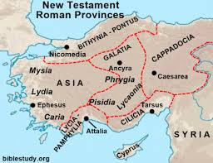
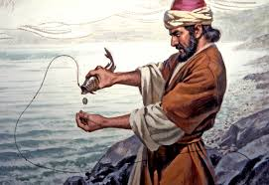
Context
 | Who? -Fisherman -One of Jesus’ very close friends (transfiguration) -A pillar of the early church ‘upon this rock I will build my church..’ -A martyr
Whom? Probably to both Jewish and Gentile believers, chosen ones, who stood out in a hostile culture Do you identify? | When & Why? AD 62-64 – shortly before Nero persecution Purpose – to encourage believers to live well under unjust suffering
Where?
‘…scattered throughout Pontus, Galatia, Cappadocia, Asia and Bithynia…’

Slide 3
What is submission? – It always involves a choice
What it’s not? Being controlled by others – cf way some women are treated Being inferior – ‘Is/was Jesus inferior to God the Father when he said in the garden, ‘Yet not my will, but yours be done?’ Being captive to another | What it is? Acknowledging & living by God’s order – ‘Can you imagine a state without a leader……..?’ Letting go of control Yielding Trusting God not ourselves Putting our hope in the promises of God Like a dance between 2 people Beautiful

Slide 4
It’s application
At a national level
At a work level
At a relationship level

Slide 5
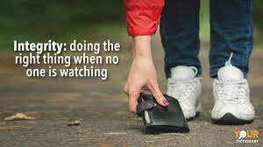
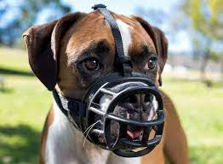
‘Submit yourselves for the Lord's sake to every human authority: whether to the emperor, as the supreme authority, or to governors, who are sent by him to punish those who do wrong and to commend those who do right. For such is the will of God that by doing right you may silence the ignorance of foolish men.’ 1 Peter 2v13-14
Response Result
Muzzle the mouth of critics
CHALLENGE – Do folk know us the church for the things we affirm or the things
we’re against?

Slide 6
‘Servants be submissive to your masters with all respect, not only to those who are good and gentle, but also to those who are unreasonable.’ 1 Peter 2v18
Response Result
Show respect even if not reciprocated
CHALLENGE – In your ‘workplace,’ do your actions and reactions reflect Jesus’ call to take the higher road? (beatitudes - returning evil for evil, insult for insult, but giving a blessing instead)

Slide 7
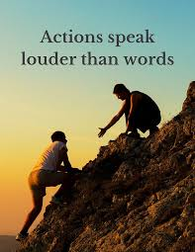
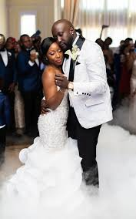
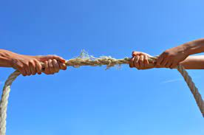
‘In the same way, you wives, be submissive to your own husbands so that even if any of them are disobedient to the word, they may be won without a word by the behaviour of their wives, as they observe your chaste and respectful behaviour’ 1 Peter 3v1-2
Response Result
IMPACT – maybe they will come to Christ
CHALLENGE – What does your marriage look like?
CHALLENGE -

Slide 8
‘To sum up, let all be harmonious, sympathetic, brotherly, kind-hearted, and humble in spirit; not returning evil for evil, or insult for insult, but giving a blessing instead; for you were called for the very purpose that you might inherit a blessing. For, ‘Let him who means to love life and see good days refrain his tongue from evil and his lips from speaking guile. And let him turn away from evil and do good; let him seek peace and pursue it. For the eyes of the Lord are upon the righteous, and his ears attend to their prayer, but the face of the Lord is against those who do evil.’ 1 Peter 3v8-12

